Slide 1


Gradient Descent

Slide 2
Agenda
01
What is Gradient Descent ?
02
Steps involved in Gradient Descent
03
Gradient Descent in Linear Regression
04
Implementing Gradient Descent Algorithm

Slide 3
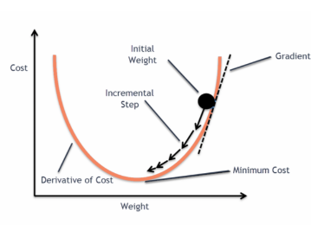
Gradient Descent
Gradient descent is one of the most popular optimization algorithms for training machine learning models by reducing errors between actual and expected value.

Slide 4
Steps involved in Gradient Descent
1
Initializing the slope and intercept as 0
Initially
m=0
c=0
Learning Rate = 0.01
2
Calculate the partial derivative of loss function with respect to m and c
3
Update the current value of m and c using the following equation
4
Repeat step 2 and Step 3 untill loss=0
(Ideally)
5

Slide 5



Steps involved in Gradient Descent
1
Initializing the slope and intercept as 0
2
Calculate the partial derivative of loss function with respect to m and c
3
Update the current value of m and c using the following equation
4
Repeat step 2 and Step 3 untill loss=0
(Ideally)
5

Slide 6


Steps involved in Gradient Descent
1
Initializing the slope and intercept as 0
2
Calculate the partial derivative of loss function with respect to m and c
3
Update the current value of m and c using the following equation
4
Repeat step 2 and Step 3 untill loss=0
(Ideally)
5

Slide 7
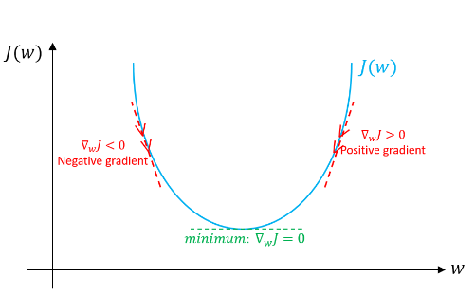
Steps involved in Gradient Descent
1
Initializing the slope and intercept as 0
2
Calculate the partial derivative of loss function with respect to m and c
3
Update the current value of m and c using the following equation
4
Repeat step 2 and Step 3 until loss=0
(Ideally)
5

Slide 8
Gradient Descent in Linear Regression

Slide 9
Dataset Information
Placement dataset contains 200 records with 2 attributes
Attributes | Description
CGPA | Current CGPA
Package | Package recived (LPA)

Slide 10
Importing the Libraries

Slide 11

Importing the Libraries
We start off this project by importing all the necessary
libraries that will be required for the process.

Slide 12
Loading the Data

Slide 13
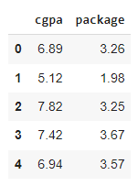

Loading the Image Data
Creating a dataframe of placement data

Slide 14
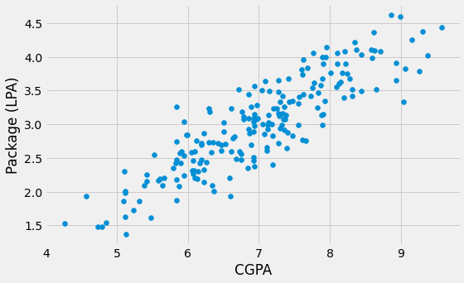

Data Visualization
Scatter plot of CGPA vs Package(LPA)

Slide 15
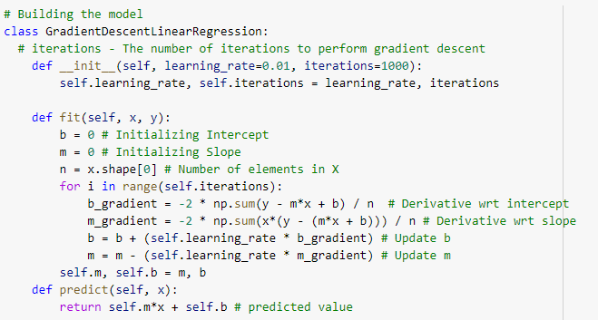
Building the Gradient Descent Model
Gradient Descent Algorithm gives optimum values of slope and intercept of the linear regression equation. With these values of m and c, we will get the equation of the best-fit line and ready to make predictions.

Slide 16

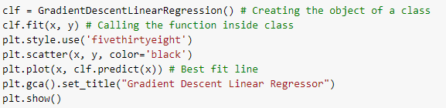
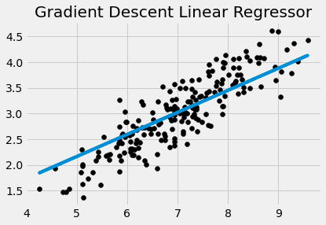


Building the Gradient Descent Model
Optimum value of slope and intercept have been obtained for the best-fit line

